Slide 1
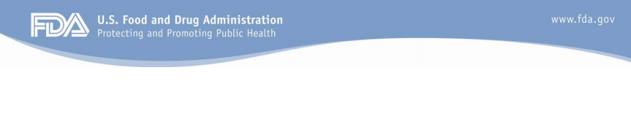
Belsomra Safety and Efficacy
Presented by NCHR at Patient Training Workshop
Slides adapted by NCHR from Ronald Farkas’s FDA Presentation

Slide 2
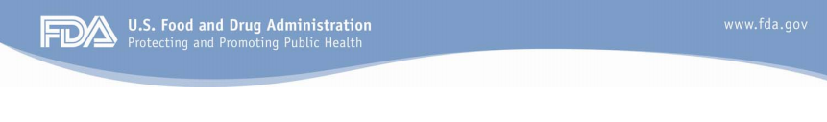
Safety concerns
Objective efficacy results
Slides adapted by NCHR from Ronald Farkas’s FDA Presentation

Slide 3
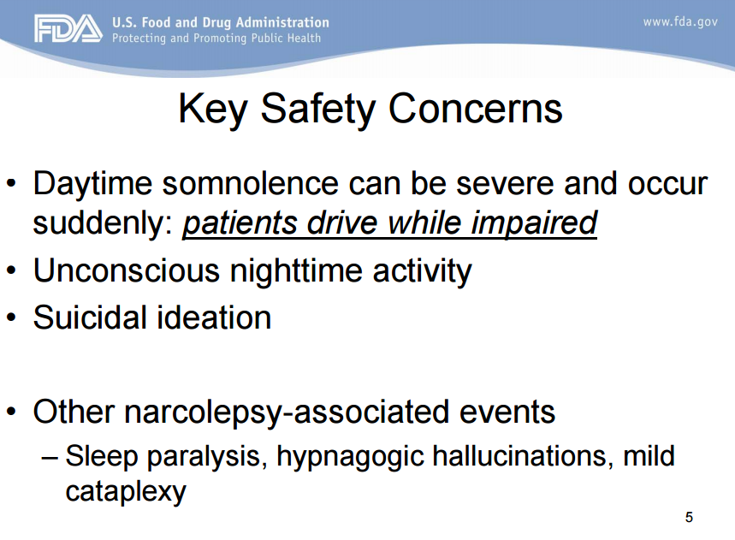
Slides adapted by NCHR from Ronald Farkas’s FDA Presentation

Slide 4
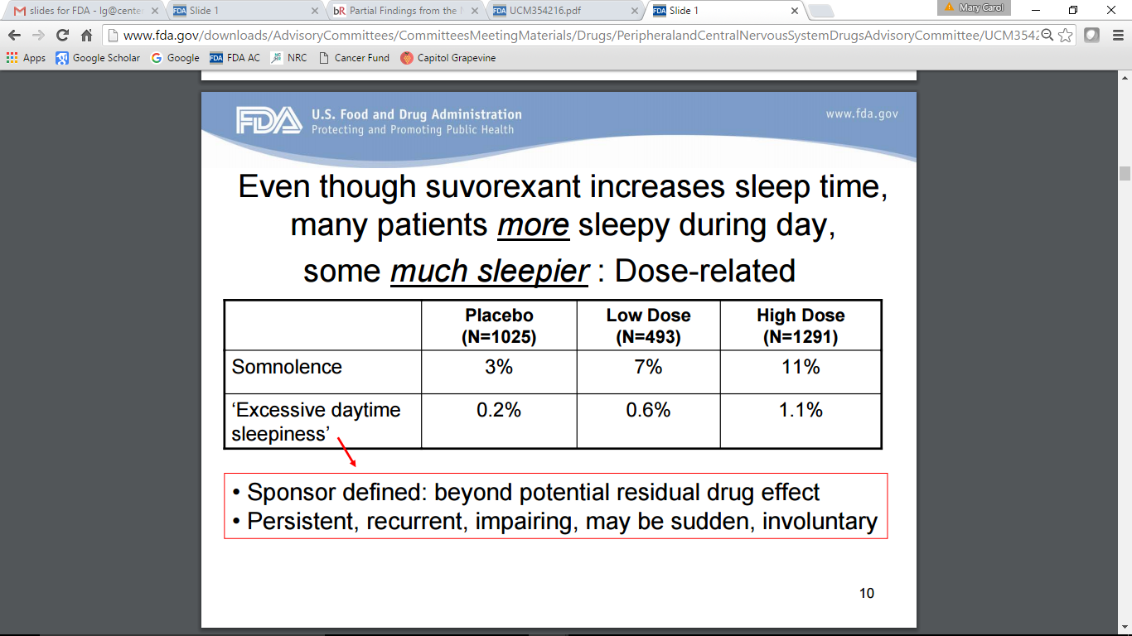
Daytime Somnolence
Slides adapted by NCHR from Ronald Farkas’s FDA Presentation
Notes:
Clearly dose related, so we need to determine the appropriate dose

Slide 5
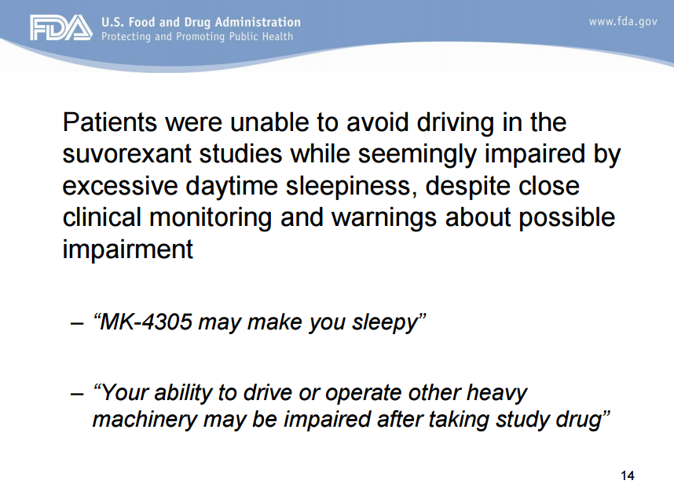
Slides adapted by NCHR from Ronald Farkas’s FDA Presentation

Slide 6
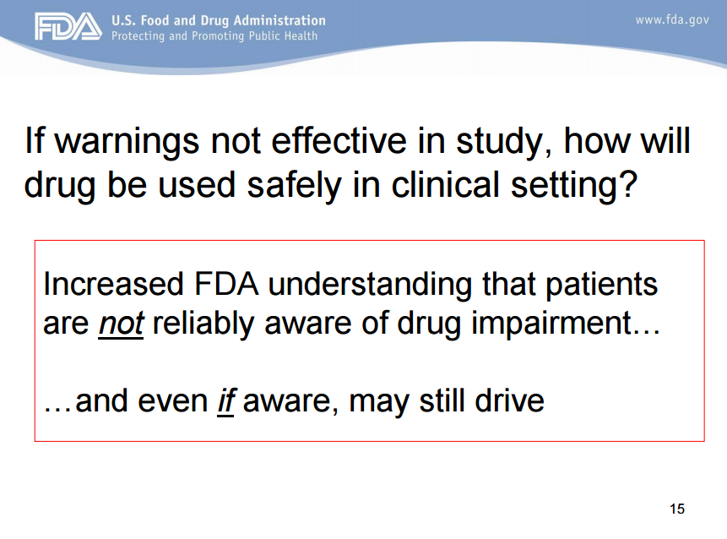
Slides adapted by NCHR from Ronald Farkas’s FDA Presentation
Notes:
Patients are reliably aware of impairment and being sleepy

Slide 7
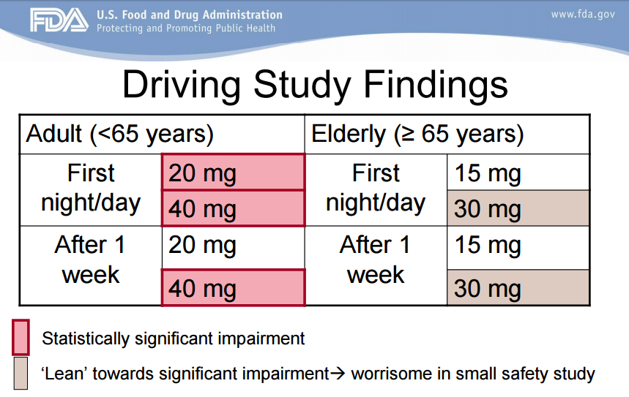
Slides adapted by NCHR from Ronald Farkas’s FDA Presentation

Slide 8
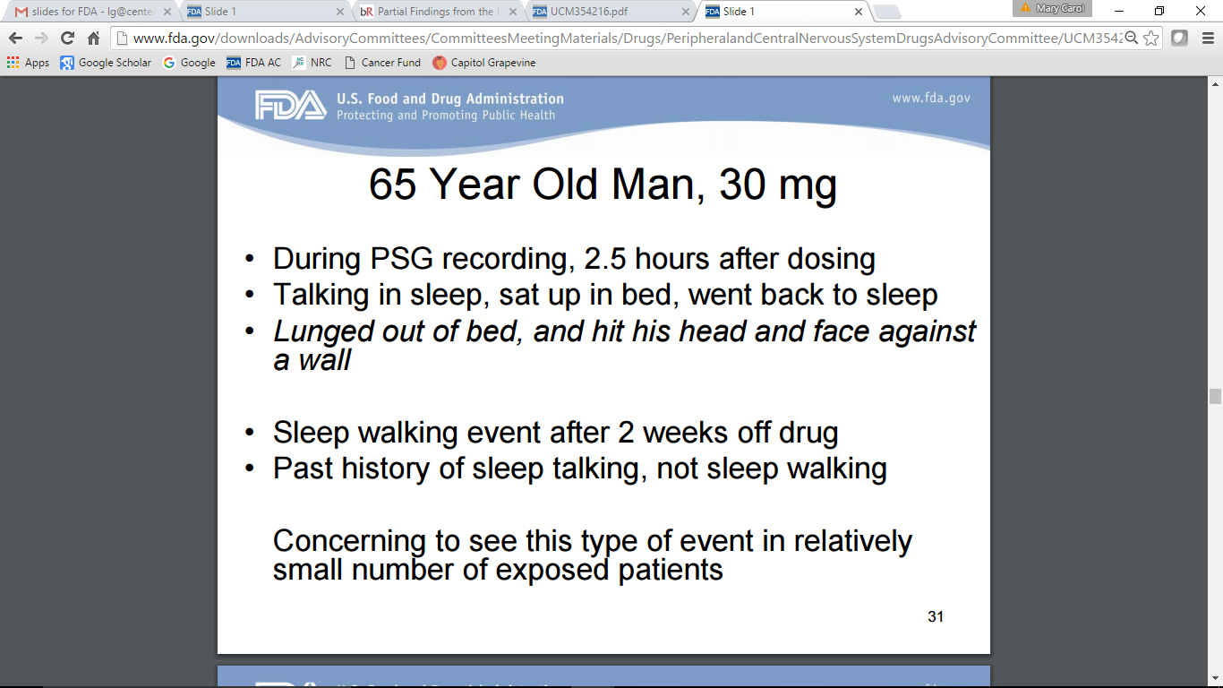
Unconscious Nighttime Behavior
65 year old man
Slides adapted by NCHR from Ronald Farkas’s FDA Presentation
Notes:
Don’t have a ton of data since people are sleeping or people around them are sleeping
Polysomnography

Slide 9
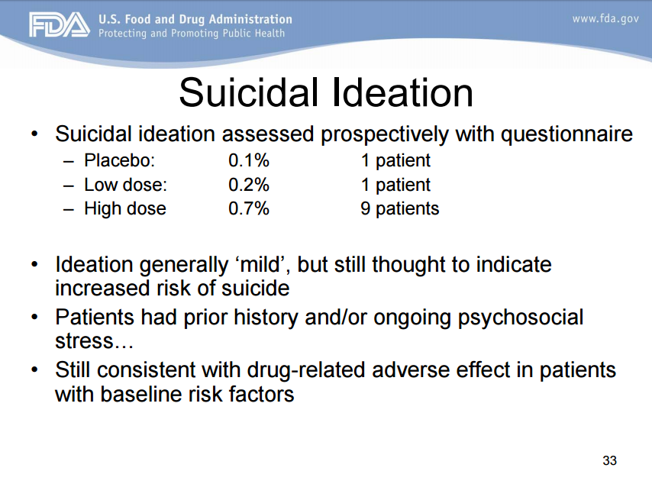
Slides adapted by NCHR from Ronald Farkas’s FDA Presentation

Slide 10
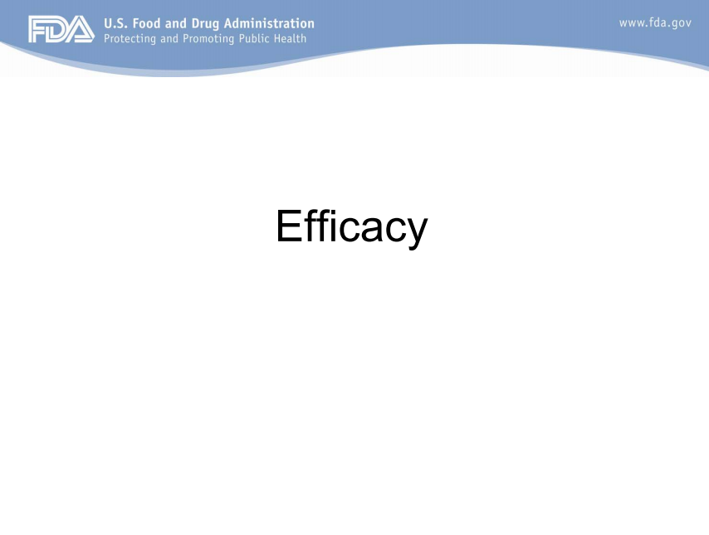
Slides adapted by NCHR from Ronald Farkas’s FDA Presentation

Slide 11
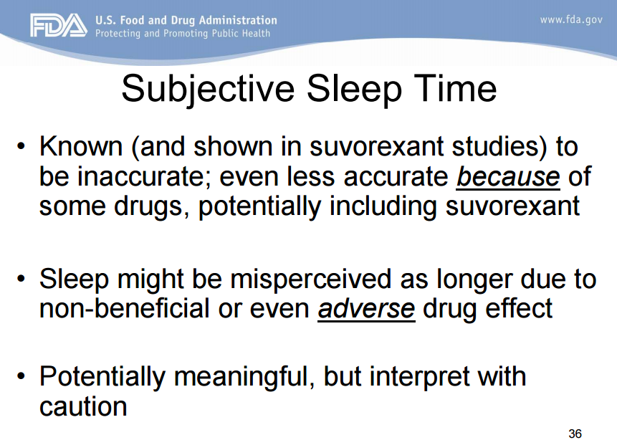
Belsomra
Belsomra
Slides adapted by NCHR from Ronald Farkas’s FDA Presentation
Notes:
Poor perception of how much they’ve slept
Can’t report how long you were awake at night because you can’t remember

Slide 12
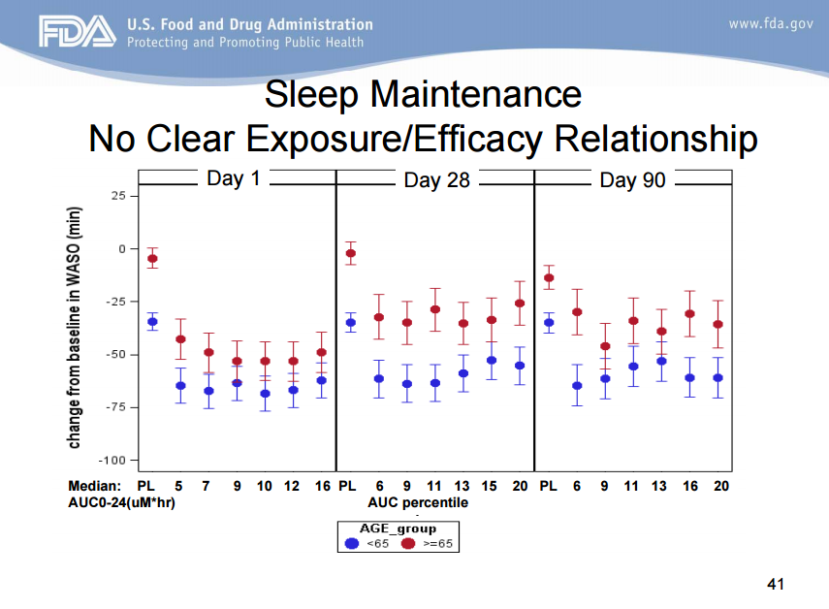
Slides adapted by NCHR from Ronald Farkas’s FDA Presentation
Notes:
Wake after onset to persistent sleep
Area under the concentration-time curve (determines the total drug exposure over a period of time)

Slide 13
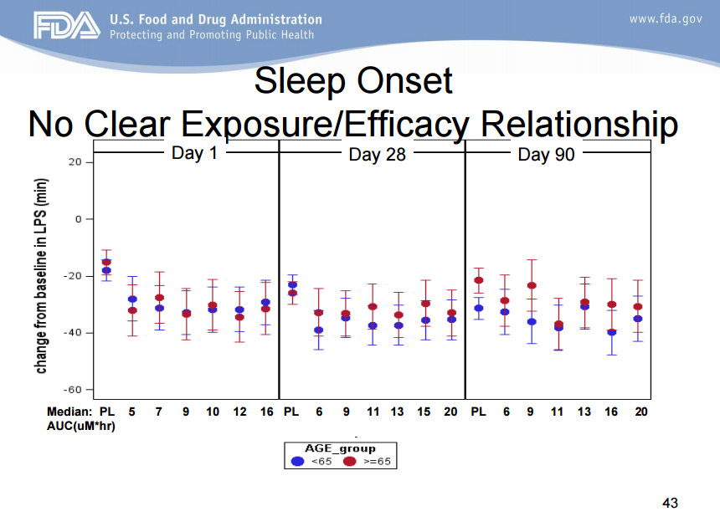
Slides adapted by NCHR from Ronald Farkas’s FDA Presentation
Notes:
Latency to the onset of persistent sleep

Slide 14
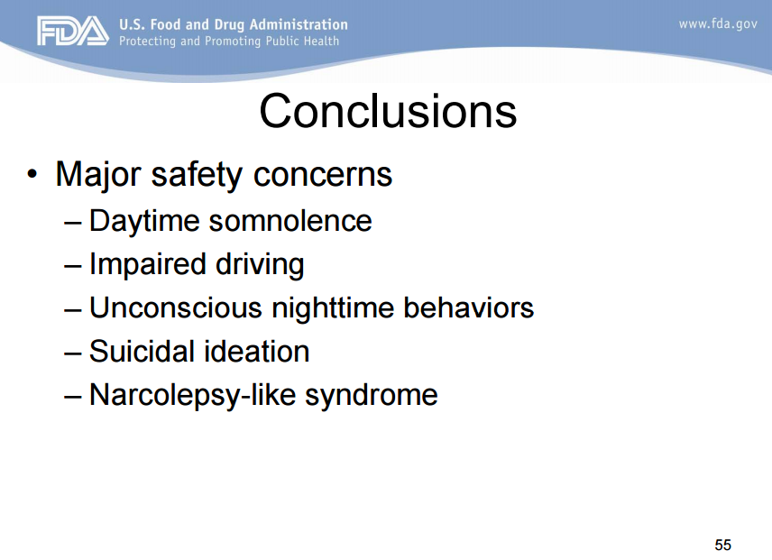
Slides adapted by NCHR from Ronald Farkas’s FDA Presentation

Slide 15
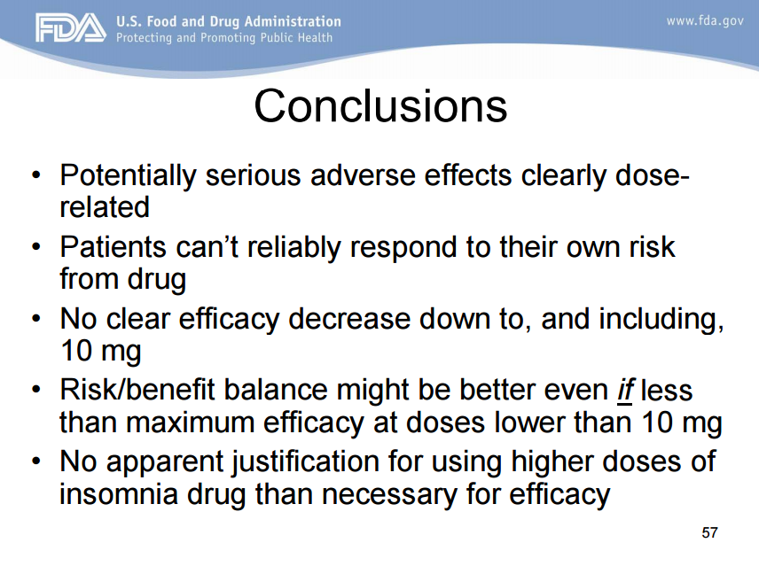
Slides adapted by NCHR from Ronald Farkas’s FDA Presentation

