Slide 1
INTRO TO Clinical Trials
Miara Jeffress, PhD
National Center for Health Research
October 14, 2016
Notes:
Good afternoon everyone,
Today we are going to learn about the kinds of studies doctors and researchers do to determine if a drug is safe and effective. These studies are called clinical trials and are required for drug approval.

Slide 2
Standard Drug Approval Criteria
Safe (2 short-term Clinical Trials)
Effective (compared to placebo)
Inspected
Notes:
In order for a drug to be approved the FDA the drug must be found safe and effective. Doctors and researchers must perform 2 short clinical trials to prove that the drug is safe and to prove that it is effective it must be compared to a placebo which is a treatment that has no effect.

Slide 3
How to set up a clinical trial
Decide on a control group and type of trial
Decide on outcomes (endpoints)

Slide 4
Types of Clinical Trials
Randomized Double Blind Clinical Trial
Randomized Single Blind Clinical Trial
Randomized Controlled Clinical Trial
Controlled Clinical Trial
Notes:
There are many different types of clinical trials.

Slide 5
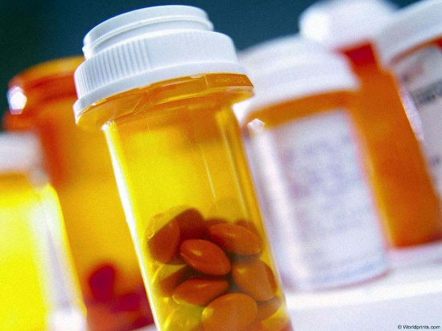
Many different types of clinical trials
Randomized Double Blind Clinical Trial
Gold Standard
Patients randomly assigned to get drug 1 or drug 2 (or placebo)
Patient doesn’t know which drug
Doctor/researcher doesn’t know which

Slide 6
Many different types of clinical trials
Randomized Single Blind Clinical Trial
Gold Standard
Patients randomly assigned to get drug 1 or drug 2 (or placebo)
Patient doesn’t know which drug
Doctor/researcher doesn’t know which

Slide 7
Many different types of clinical trials
Randomized Controlled Clinical Trial
Gold Standard
Patients randomly assigned to get drug 1 or drug 2 (or placebo)
Patient doesn’t know which drug
Doctor/researcher doesn’t know which

Slide 8
Many different types of clinical trials
Controlled Clinical Trial
Gold Standard
Patients randomly assigned to get drug 1 or drug 2 (or placebo)
Patient doesn’t know which drug
Doctor/researcher doesn’t know which
2 patient groups are similar or matched on age, sex, diagnosis.

Slide 9
Many different types of clinical trials
Uncontrolled Clinical Trial
Gold Standard
Patients randomly assigned to get drug 1 or drug 2 (or placebo)
Patient doesn’t know which drug
Doctor/researcher doesn’t know which
2 patient groups are similar or matched on age, sex, diagnosis.

Slide 10
Types of Controls (Comparisons)
New drug compared to placebo (or device compared to a sham)
New drug compared to an old drug
New drug compared to historical controls

Slide 11
How to set up a clinical trial
Decide on a control group and type of trial
Decide on outcomes (endpoints)

Slide 12
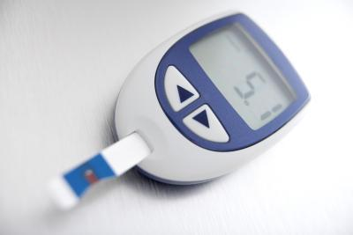
Health Outcomes
Overall Survival
Better Health
Fewer Days in the hospital
Better Quality of Life

Slide 13
“Surrogate” Health Outcomes
cholesterol levels
glucose levels
bacteria in a test tube
tumor size or
“progression-free” survival

Slide 14
What’s the Difference?
A drug can lower cholesterol but not help a patient live longer
Chemo can kill cancer cells and also make a patient’s life miserable
KEY QUESTION:
How sure are you that the biomarker = health?

Slide 15
Did Avastin actually work?
 | Chemo + Placebo | Chemo + Avastin
Progression-free Survival | 7.8 months | 8.8 months
p-value | Highly significant | 0.0003
Notes:
15

Slide 16
Did Avastin actually work?
 | Chemo + Placebo | Chemo + Avastin
Overall Survival | 31.9 months | 30.2 months
p-value | Worse but not “significant” | 0.98
Overall Survival worse with Avastin
Notes:
16

Slide 17
Which outcome you measure can make a major difference?
Progression-free survival better with Avastin
Overall survival worse with Avastin
Cancer growth slowed down but patients did not live as long on Avastin.

Slide 18
P-value = probability the result is statistically significant
P-value tells us how confident the results are to be due to the drug, and not chance.
P-value of 0.05 or less is statistically significant. 95% chance it is a “real difference and less than 5% likelihood that it happened by chance
Statistically significant does NOT mean that the difference is large or important. It means it probably didn’t happen by chance.

Slide 19
Questions to Ask about Trial Design
Will we be able to tell if the treatment group does better than the control?
Were the patients in treatment and control groups similar, or were some healthier than others before treatment?
Is the statistically significant result meaningful to patients?

Slide 20
Group Activity # 1
IDENTIFY THE CLINICAL TRIAL

