Slide 1
Patient Engagement at the FDA and NIH Patient Training Workshop June 2-3, 2017
Notes:
Good afternoon, I’m Paul Brown….
Three ways Patient Advocates can influence the Food and Drug Administration
Also, ways you can influence the National Institutes of Health.

Slide 2
FDA Engagement Options
Oral public comments
Written comments
Representative on FDA advisory committee
Notes:
3 ways patients can get engaged with FDA include
Speak at FDA meetings.

Slide 3
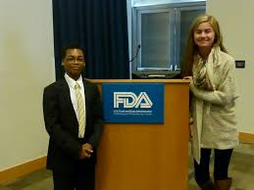
FDA: Finding Opportunities
Federal Register: https://www.federalregister.gov/
Sign-up for email alerts from Federal Register
FDA email updates (Daily Digest Bulletin): https://service.govdelivery.com/accounts/USFDA/subscriber/new?topic_id=USFDA_62
FDA Patient Network: http://www.fda.gov/ForPatients/default.htm
Patient Representative: http://www.fda.gov/ForPatients/About/ucm412709.htm
Notes:
How do you find out about opportunities to comment at meetings, submit written comments or become a patient rep?
Several ways.
What’s missing in the Federal Register? For comments, link to FDA Draft Guidances http://www.fda.gov/RegulatoryInformation/Guidances/

Slide 4
FDA: Oral Public Comments
Email contact in Federal Register to request to speak
Note deadline in Federal Register for signing up
For advisory committee meetings
Review background materials posted online 48 hours prior to meeting
Notes:
Sign up in advance. Send an email to the FDA’s contact person. Deadline buried.
Only 48 hours but talk about issue you have personal experience with.
Info FDA wants: Contact info plus how much time you’re requesting.
Also a “brief statement of the general nature of the evidence or arguments you wish to present.”
Tell them you’re commenting on the s/e of the medical product. Don’t need details.
Or you can state: “pending the review of the bg info.”

Slide 5
FDA: Oral Testimony Tips
Be clear and concise
Be sure your comments fit within your time limit
Focus on 2 – 3 main points
Use plain language
Avoid the temptation to speak too fast
Notes:
What makes good testimony?

Slide 6
FDA: Components of Effective Testimony
Introduction
State your position
State your concerns
State your recommendation
Notes:
Here’s an outline of effective testimony:
Intro: Briefly state who you are. If you represent an organization, name the group. State whether or not you have financial COIs. Your perspective on the issue (as a patient, as someone who represents many patients, or a family member or friend of a patient).
State your position: Are you for or against approval of the medical product? Or if it is a meeting about w/d a product from the market…
State your concerns: Is the product s/e (benefits outweigh risks)? Is there a lack of LT studies? Lack of diversity (subpops)? Does the evidence presented rely on bio markers or surrogate endpoints (give example of cholesterol lowering drugs that don’t prevent heart attacks)?
Your recommendations: Restate your position on the issue and tell FDA what you’re asking for…what you want them to do.
NOTE: Personal stories can be very powerful. Especially if the story illustrates a problem that many people are having. “This happened to me or my family member and it has happened to x number of others too.”

Slide 7
FDA: Submitting Written Comments
Follow the same principles for good oral comments
Be clear and concise
Focus on 2-3 main points
Use plain language
Include an introduction, state your position, state your concerns, make your recommendation
Submit your comments here: http://www.regulations.gov/#!home
Notes:
The Patient web page has a link to tips for submitting comments. Some of the best tips:
Identify credentials and experience that may distinguish your comments from others. If you are commenting in an area in which you have relevant personal or professional experience (i.e., scientist, attorney, fisherman, businessman, etc.) say so.
Support your comment with substantive data, facts, and/or expert opinions. Agency reviewers look for sound science and reasoning in the comments they receive.
Including examples of how the issue would impact you negatively or positively.
Regarding Form Letters: A single, well-supported comment may carry more weight than a thousand form letters.

Slide 8
SUBMITTING COMMENTS ON DRAFT GUIDANCES AND OTHER ISSUES /
Enter the docket number in the box and follow the instructions. The Federal Register announcement includes the docket number. It usually looks like this: [Docket No. FDA-2014-N-1210] CAUTION: Always submit comments in a PDF document. Word documents can be changed, and often tracked changes are visible.
Find draft guidance docs at http://www.fda.gov/RegulatoryInformation/Guidances/
Submit comments at
https://www.regulations.gov
Notes:
What’s missing? The Docket Number. You get that from the FR.

Slide 9
FDA: Role of the Patient Representative
Offer the patient’s perspective
Provide your recommendations and thoughts
Vote on the decision at hand (if you are a voting member)

Slide 10
FDA: Patient Representative Requirements
You must be a U.S. citizen and at least 18 years old and have:
Personal experience with the disease either as a patient, or caregiver for a family member or friend
Ability to be objective while representing the concerns of other patients
Knowledge about treatment options for the disease and research in that area
Willingness to communicate your views
No financial or ethical conflicts of interest for self or close family member
Notes:
What do Pat Reps do? Offer patient’s perspective, ask questions, and give comments to assist the committee in making recommendations to the FDA.
NOTE: FDA usually but not always follows the voting recommendations of its ACs.

Slide 11
WHERE TO FIND INFO ABOUT PATIENT REP OPENINGS
Patient Representative: http://www.fda.gov/ForPatients/About/ucm412709.htm
Notes:
Go to Patient Rep web site.
FDA has 33 ACs and one (Medical Devices AC) has 18 panels. So there’s a lot of opportunities to be a Patient Rep.
What’s missing? Link to actual advisory committees

Slide 12
FDA: How to Apply to be a Patient Representative
Your application should include:
Your personal experience with a disease
Why you want to be a Patient Rep
Your advocacy work
Work and/or volunteer experience related to the specific disease
Info about your ability to represent patients and communicate their perspectives
Email your application to: PatientRepProgram@fda.hhs.gov
Notes:
Are Pat Reps paid? Yes, but you’re not going to get rich. FDA pays a salary for the time spent in meetings & covers travel expenses (if meeting is more than 50 miles from your home).Pat Reps…meetings in DC area over 1 or 2 days.
Do Pat Reps vote on ACs? Usually on drugs and biologics ACs. Not on medical devices.

Slide 13
FDA: Office of Patient Affairs
FDA is considering establishing an “Office of Patient Affairs”
Would elevate the current Office of Health and Constituent Affairs
Central Commissioner Office resource for patients and advocates
Single, central entry point to the agency for patient community
Required by FDA Safety and Innovation Act of 2012

Slide 14
FDA: Office of Patient Affairs
Objectives
Explore patients’ attitudes about risk/benefit analysis
Solicit patients’ views during medical product development
Connect patients and their advocates with appropriate resources
Gather patient input on what is clinically meaningful to them
Consider patients’ perspectives during regulatory discussions

Slide 15
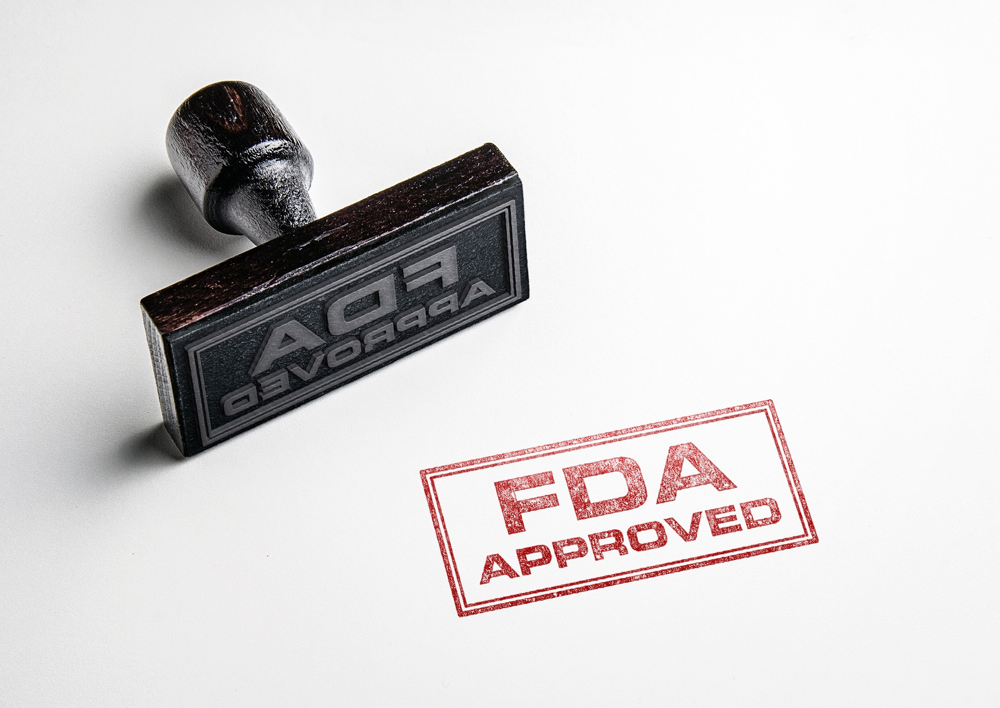
FDA: Office of Patient Affairs
Leader of the Office of Patient Affairs would be a senior FDA official
FDA collecting comments on this proposal through June 12
Both NCHR and the USA Patient Network are submitting comments

Slide 16
Opportunities for Patient Engagement

Slide 17
NATIONAL INSTITUTES OF HEALTH
NIH HAS 27 DIFFERENT INSTITUTES & CENTERS
FROM THE NATIONAL EYE INSTITUTE TO THE NATIONAL CANCER INSTITUTE TO THE NATIONAL INSTITUTE ON AGING & MORE
HTTPS://OMA.OD.NIH.GOV/IC_ORGANIZATION_CHART/NIH%20ORGANIZATIONAL%20CHART.PDF
Notes:
NIH is our nation’s research agency and it’s part of HHS.

Slide 18
NIH: National Heart, Lung, and Blood Institute (NHLBI)
http://www.nhlbi.nih.gov/files/docs/public/nhlbi-listens.pdf

Slide 19
NHLBI: Collaboration with Advocacy Groups
And many others!
Email for more information:
NIHinfo@od.nih.gov

Slide 20
WHEN THE PUBLIC SPEAKS, THE NHLBI LISTENS AND RESPONDS
THE NHLBI SEEKS INPUT FROM PUBLIC INTEREST ORGANIZATIONS .
INTERACTION WITH PATIENT ADVOCACY GROUPS CAN HAVE A POSITIVE EFFECT ON RESEARCH.
THE INSTITUTE BELIEVES IT PUTS A HUMAN FACE TO THE DISEASES THEY STUDY & IMPROVES THEIR ACCESS TO PATIENTS FOR CLINICAL STUDIES.

Slide 21
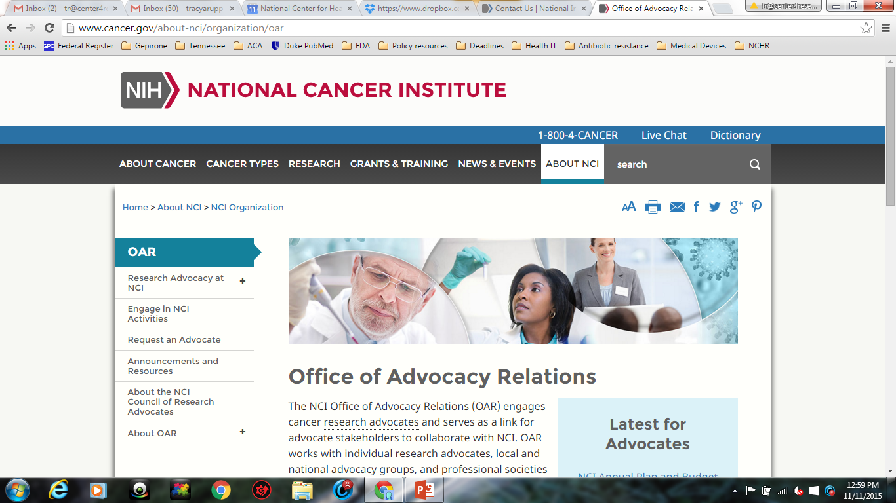
NIH National Cancer Institute: Office of Advocacy Relations
http://www.cancer.gov/about-nci/organization/oar

Slide 22
Advocate Roles at NCI
Advocates bring a human face to cancer research that reinforces the need to accelerate progress.
Their involvement provides NCI staff with critical feedback and insight. There are four primary ways advocates engage in the NCI research process…

Slide 23
NCI: Research Advocacy Process
Advise
Design
Review
Disseminate
Notes:
Advocates bring a human face to cancer research. Four primary ways advocates engage in the NCI research:
Advise – develop recommendations, provide patient perspectives at formal advisory boards and by speaking at meetings.
Design – contribute to research design, ID barriers to implementation
Review – assess progress and effectiveness & edit scientific language to improve readability for the general public.
Disseminate – distribute research findings to nonscientific audiences

Slide 24
NCI Research Advocate Requirements
At least 2 years of involvement with cancer research-related activities
Personal experience with cancer
Ability to express a “collective patient perspective”
Residency in the United States
Fluency in English
Notes:
Office of Advocacy Relations. OAR assesses NCI programmatic needs and the skills, interests, and experience of each advocate to connect the right advocate to the right activity so he or she can provide the most effective contributions when working with NCI. At a minimum, an NCI research advocate must have:
More than two years of involvement in cancer research-related activities
Personal experience with cancer
Been diagnosed with cancer
Connected to someone who has been diagnosed with cancer (e.g. family member, caregiver, health care professional with direct patient contact, professional staff at advocacy organization, etc.)
Ability to demonstrate a collective patient perspective, meaning knowledge of multiple disease experiences and the ability to convey this collective perspective rather than one's own exclusive experience
There are occasions when an individual perspective is appropriate
Residency in the United States
Fluency in English
Inclusion in NCI activities depends on the above criteria as well as current advocate needs and experience.

Slide 25
Become an NCI Research Advocate
Create
Select
Prepare
Participate
Evaluate
Notes:
Process to become an advocate:
Create: OAR will assist you in creating a profile in the research advocate system.
Select: OAR will contact you when an activity that matches your skills and expertise is available. If you are interested, OAR will share your name and contact information with the requester for consideration.
Prepare: If you choose to participate, OAR and the requester will prepare you for the activity.
Participate: You will participate in the activity by providing the requester with insight that reflects the collective patient perspective.
Evaluate: After the activity is over, OAR will seek your feedback and ask you and the requester to complete an evaluation.

Slide 27
NCI Office of Advocacy Relations
Phone: 301-594-3194
Email: NCIadvocacy@nih.gov
Web: www.advocacy.cancer.gov
Notes:
Phone: 301-594-3194
Email: NCIadvocacy@nih.gov
Web: advocacy.cancer.gov

Slide 28
Questions?
Phone: (202) 223-4000
Jack Mitchell: jm@center4research.org

