Slide 1
Introductory Patient Training Workshop
USA Patient Network

Slide 2
Introduction to the FDA:
What Patients Need to Know
Diana Zuckerman, PhD, President
National Center for Health Research

Slide 3
FDA Approval: Drugs & Devices
Safe and Effective means the benefits outweigh the risks for most patients
Who decides?
How do you quantify?
Your voice can be part of the process
Benefits
Risks

Slide 4
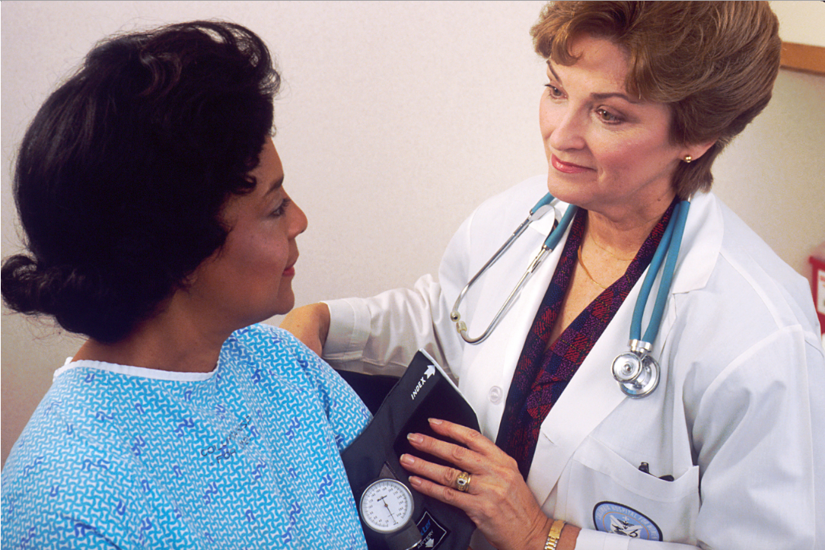
Standard Drug Approval Criteria
Safe (studied on humans)
Effective
Inspected

Slide 5
Clinical Trials
Will prove product is safe and effective if health outcomes are studied
Health outcomes include:
Survival
Fewer days in hospital
Fewer serious or unpleasant side effects
Quality of life
Fewer symptoms such as pain, nausea, etc.

Slide 6
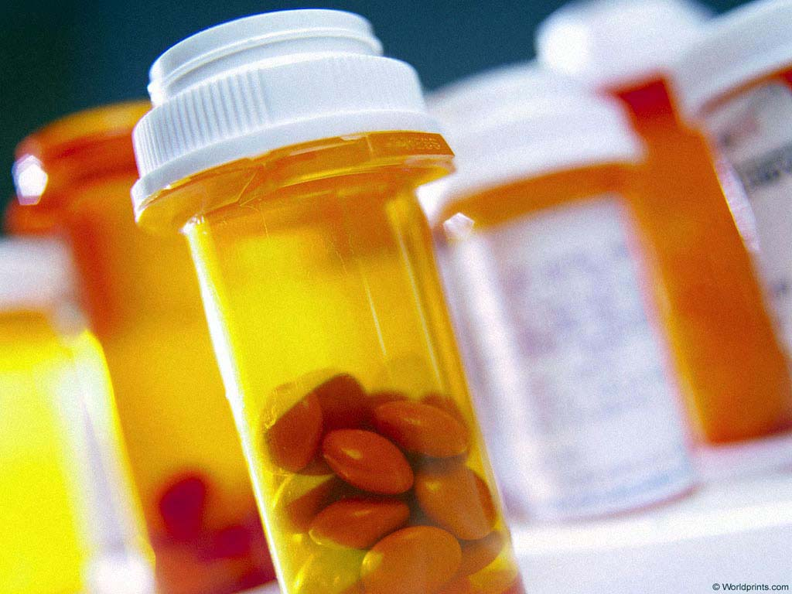
The Gold Standard:
Randomized Double Blind Clinical Trial
Patients randomly assigned to get drug 1 or drug 2 (or placebo)
Patient doesn’t know which drug
Doctor/researcher doesn’t know which drug

Slide 7
Controlled Clinical Trial
Patients or doctors choose who gets which drug
Compare patients receiving Drug #1 with patients receiving Drug #2 (or placebo)
2 patient groups are similar or matched on age, sex, diagnosis

Slide 8
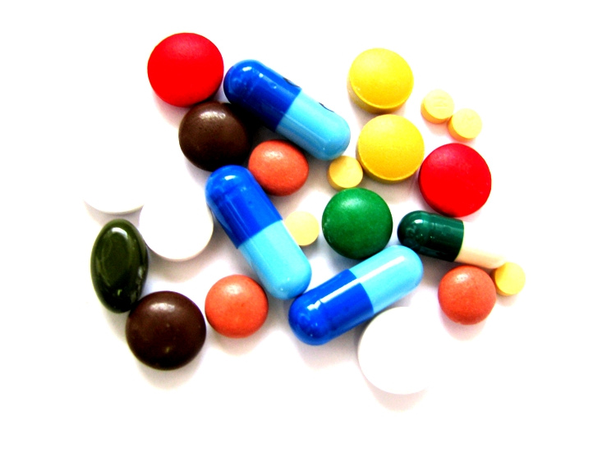
Standard Drug Approval Criteria
Safe in 2 short-term Clinical Trials
Effective compared to placebo

Slide 9
Faster Clinical Trials
Fast track or “expedited” reviews often rely on just one study
Science is based on replication
Often, results from one study aren’t typical

Slide 10
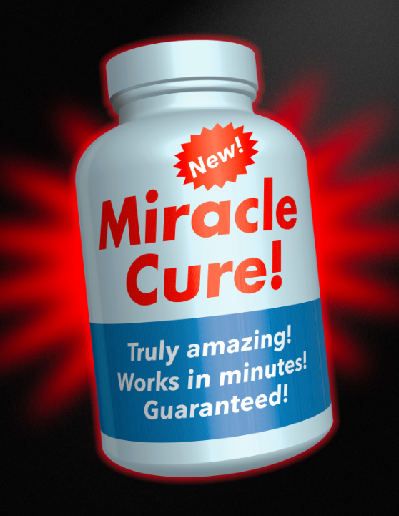
Faster Clinical Trials
Fast track or “expedited” reviews often rely on surrogate endpoints or biomarkers:
Cholesterol levels
Glucose levels
Bone mineral density
Progression free survival

Slide 11
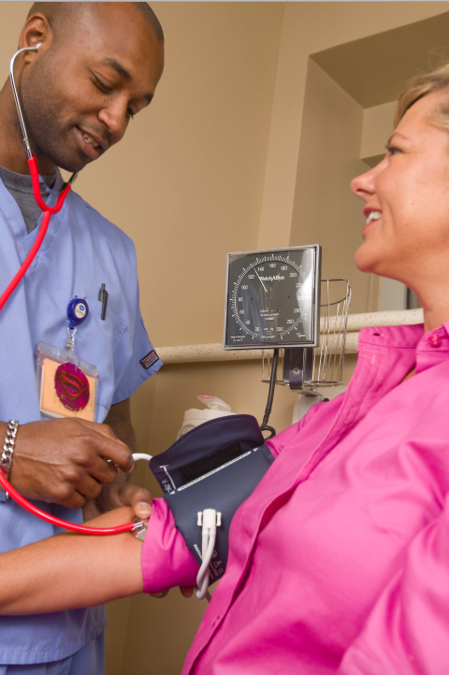
What’s the Difference?
A drug can lower glucose but not help diabetics live longer or healthier lives
A drug can lower blood pressure but not save lives
A screening test can prevent death from cancer but patient won’t necessarily live longer

Slide 12
What’s the Difference?
Chemo can kill cancer cells and also make a patient’s life miserable – and can even kill them
KEY QUESTION:
How sure are you that the biomarker = health?

Slide 13
Compromise: Promise to do Better Studies After Approval
Would you rather be in a free clinical trial or pay for an unproven treatment?
KEY QUESTION:
Should patients be guinea pigs for years or wait until a treatment is proven to work?

Slide 14
Fast Tracked TB Drug
We need new TB drugs because of resistant bacteria
Sirturo, the first new TB drug in 40 years, was approved based on a surrogate endpoint (stopping bacterial growth).
Designated fast track, priority review and an orphan product.

Slide 15
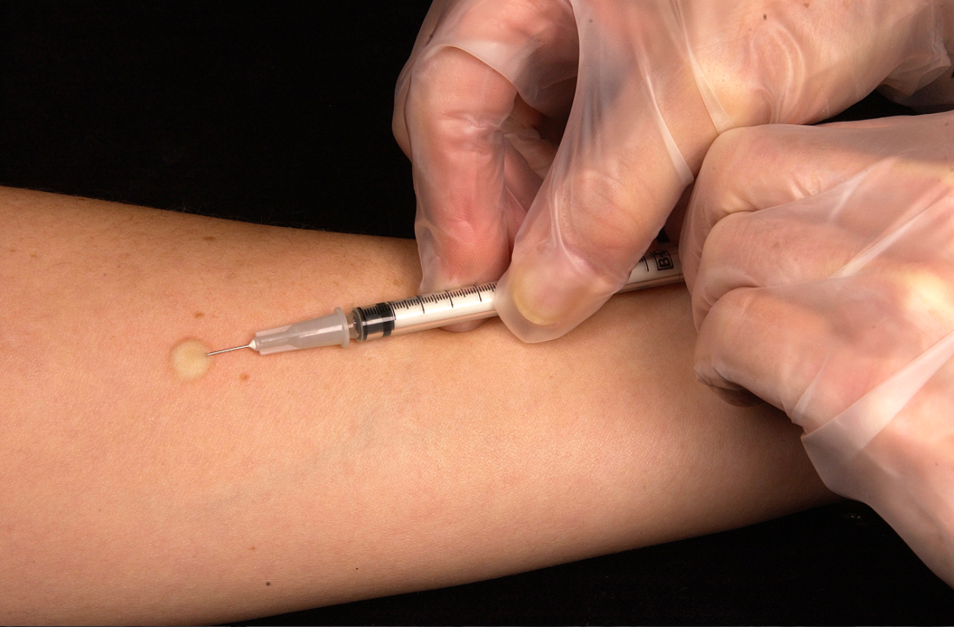
Fast Tracked TB Drug
Research shows that TB patients taking Sirturo with old drugs 5x as likely to die as those taking just the old TB drugs.
What will happen in the real world? We don’t know yet.
FDA is requiring additional research (post-market study). When will it be done?

Slide 16
PSA Tests for Prostate Cancer
Patients who are screened are less likely to die from prostate cancer.
...but patients don’t live any longer. They die of something else.

Slide 17
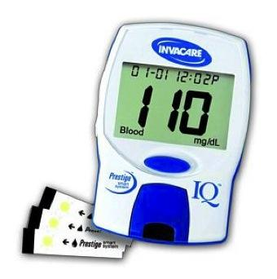
Device Approval Criteria
Reasonably safe
Reasonably effective
95+% are not studied in clinical trials

Slide 18
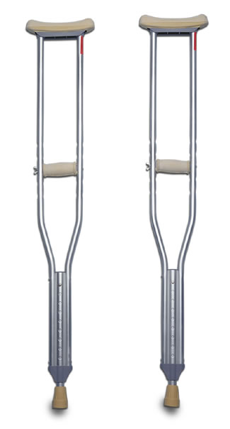
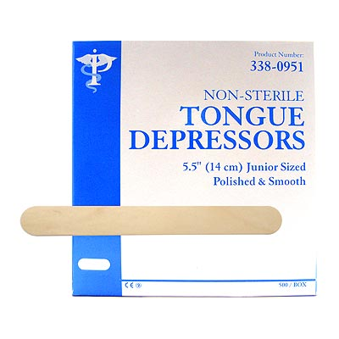
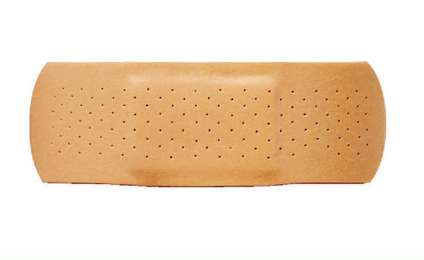
Low Risk: Not Tested

Slide 19
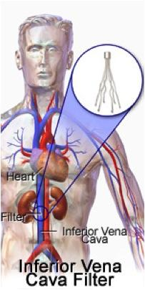
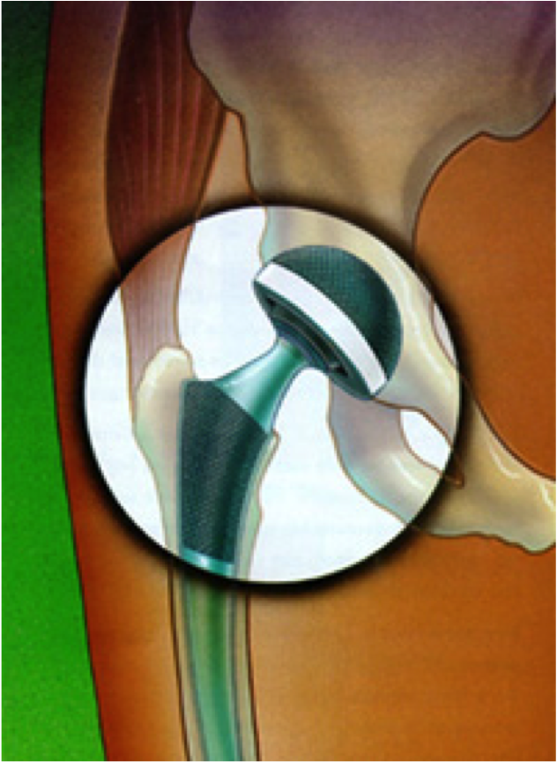
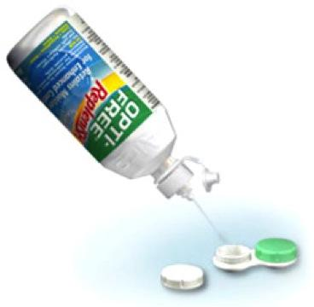
Moderate Risk (510k)

Slide 20
98% are “Moderate Risk”
Reviewed through the 510(k) process
Not tested for safety or efficacy
Must be Substantially Equivalent to other devices legally on the market
No clinical trials
No inspections
No studies required post-market

Slide 21
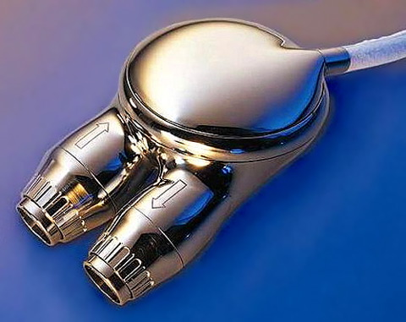
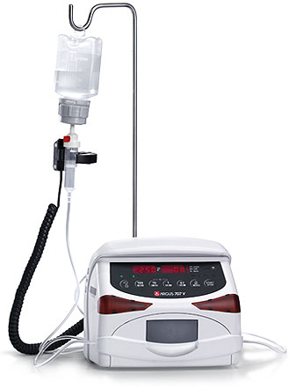
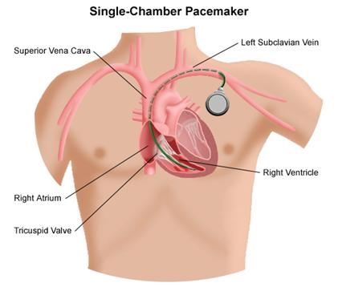
High Risk Medical Devices (pacemaker, heart, infusion pump)

Slide 22
Highest Risk Devices: PMA
Implants, life-saving or life-sustaining
Premarket Approval
Reasonably safe
Reasonably effective
One clinical trial (not double blind) with smaller sample than required for prescription drug data

Slide 23
FDA Approval of
Drugs and Devices
Does NOT mean:
Nobody will die from this product
Few will be harmed by this product
This product is safe for long-term use
This product is more effective OR cheaper than products on the market

Slide 24
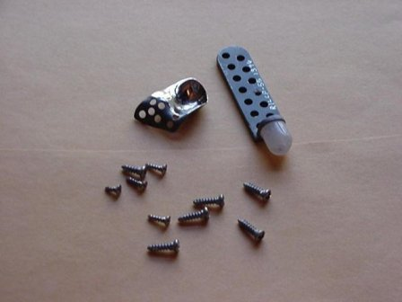
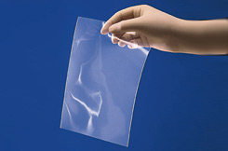
Are these substantially equivalent?
?
=
Dow silicone sheet
Vitek TMJ implants

Slide 25
Temporary Mandibular Implant
Temporarily replace bone removed due to oral cancer
Study: Temporary use
Reality: not temporary - serious health risks; no long-term info

Slide 26
OsteoMed Temporary Condylar Implant
Images from Driemel, O. et al. Int. J. Oral Maxillofac. Surg. 2009
“Substantially equivalent”?: Yes, according to the FDA
...but new design includes moveable parts!

Slide 27
Spinal Screw Systems
Used with spinal fusion surgery
Spinal surgery is risky
Clinical trials not required for new spinal screw systems

Slide 28
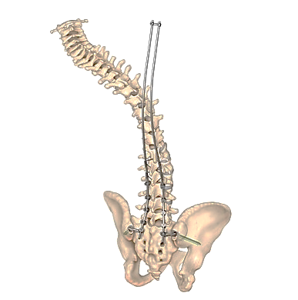
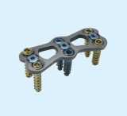
DePuy VIPER Spinal System
Changed dramatically since 1996
Differences: Added or modified parts, new complex systems have not been tested
?
=
DePuy Spinal System, 2011
Anterior Plate Fixation System

Slide 29
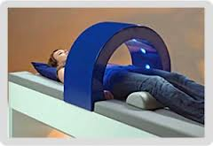
Nonthermal Shortwave Diathermy Devices for Pain
Not enough safety & effectiveness data for old ones or new ones
Substantially equivalent?
Differences: Length & frequency of treatment time
?
=

Slide 30
Device Recalls
Almost half a billion 510(k) devices were recalled as high risk in one year, including contaminated alcohol swabs that killed this boy.

Slide 31
Conclusions
Gold standard: 2 double blind randomized clinical trials studying patients’ health
Today’s FDA rarely requires this standard for fast track drugs and almost never requires it for devices
95+% of medical devices have no clinical trials or proof of safety or efficacy

Slide 32
Implications
Whether a patient cares more about speed of getting drugs and devices to market or good safety data will depend on the treatments available.
Desperate patients may choose riskier treatments. How long should companies be allowed to sell unproven treatments?
Remember that risk can mean shorter life, worse quality of life. Should patients pay for that?

Slide 33
Implications
Good quality research takes years to do.
Meanwhile, experimental drugs are not widely available--some patients will die waiting.
New medical products may be better or may be worse: that’s why clinical trials on women and men are needed.

Slide 34
Introduction to the FDA:
What Patients Need to Know
Diana Zuckerman, PhD, President
National Center for Health Research

