Slide 1
INTROduction TO Clinical Trials
Megan Polanin, PhD
National Center for Health Research
June 2, 2017
Notes:
Good afternoon everyone,
Today we are going to learn about the kinds of studies doctors and researchers do to determine if a drug is safe and effective. These studies are called clinical trials and are required for drug approval.

Slide 2
Standard Drug Approval Criteria
Safe (2 short-term clinical trials)
Effective (compared to placebo)
Notes:
In order for a drug to be approved by the FDA, the drug must be found safe and effective, which means that it is successful in producing some sort of desired result (e.g. Does a medication intended to help someone sleep actually help people sleep?). Doctors and researchers must perform 2 short clinical trials to prove that the drug is safe. To prove that it is effective, it must be compared to a placebo which, is an inactive treatment that is not supposed to have an effect.

Slide 3
Clinical Trials
Control group
Type of trial
Patient population
Size of trial
Outcomes
Notes:
As a patient, it is important to know how clinical trials are set up so you can understand what goes into proving whether treatments are safe for you. First, you need to decide on a control group and figure out what type of trial is right for the study of the specific drug or treatment. The population of the disease affects and the treatment options that are currently available can all have an effect on what type of trial would be best.

Slide 4
Types of Clinical Trials
Randomized Double Blind Clinical Trial
Randomized Single Blind Clinical Trial
Randomized Controlled Clinical Trial
Controlled Clinical Trial
Notes:
There are many different types of clinical trials.

Slide 5
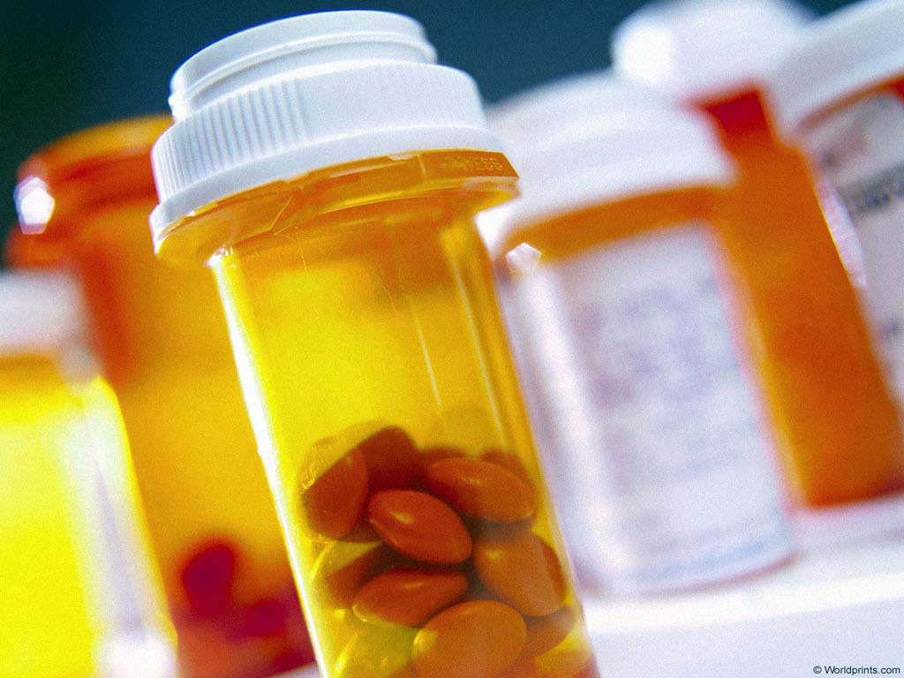
Types of Clinical Trials
Randomized Double Blind Clinical Trial
“Gold Standard”
Patients randomly assigned to get drug 1 or drug 2 (or placebo)
Patients don’t know which drug
Doctors/researchers don’t know which drug
Notes:
The gold standard of all trials is the randomized double blind clinical trial. In this trial, patients are randomly chose to get drug 1 or drug 2. In this type of trial, there is no bias since the doctor doesn’t know which drug the patient received and the patient doesn’t know either. That way neither the doctor nor the patient can influence the results of the study.

Slide 6
Types of Clinical Trials
Randomized Single Blind Clinical Trial
Patients randomly assigned to get drug 1 or drug 2 (or placebo)
Patients don’t know which drug
Doctors/researchers DO know which drug

Slide 7
Types of Clinical Trials
Randomized Controlled Clinical Trial
Patients randomly assigned to get drug 1 or drug 2 (or placebo)
Both patients AND doctors/researchers know which drug they were assigned

Slide 8
Types of Clinical Trials
Controlled Clinical Trial
Patients or doctors choose who gets which drug (not random)
Compare patients receiving Drug #1 with patients receiving Drug #2 (or placebo)
2 patient groups are similar or matched on age, sex, diagnosis

Slide 9
Types of Clinical Trials
Non-Controlled Clinical Trial
Patients assigned to get a drug
No control group

Slide 10
Types of Controls (Comparisons)
New drug compared to placebo (or medical device compared to a sham)
New drug compared to an old drug
New drug compared to historical controls
Notes:
Sham = device that is inserted, but is not functional.
New drug is not required to be BETTER than the old drug – it is just required to be similar.

Slide 11
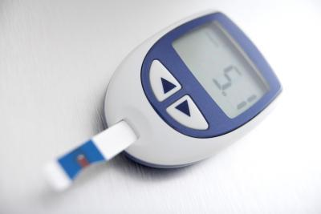
Health Outcomes
overall survival
better health
fewer days in the hospital
better quality of life
Notes:
Some outcomes doctors look at our overall survival so how long you live after diagnosis, better health, are fewer days spent in the hospital and did the patient’s quality of life improve.

Slide 12
Surrogate Endpoints/Biomarkers
cholesterol levels
glucose levels
bacteria in a test tube
tumor size or “progression-free” survival
Notes:
Might use these when the real health outcome is very infrequent (like overall survival rate, for example), thus making it impractical to conduct a clinical trial.
Some examples of surrogate outcomes are cholesterol levels, glucose levels, bacteria in a test tube, tumor size or progression free survival which is how long you live without the cancer getting worse.

Slide 13
What’s the Difference?
A drug can lower cholesterol, but not help a patient live longer
Chemo can kill cancer cells and also make a patient’s life miserable
Biomarkers = Health?
Notes:
So what’s the difference between the two just because the drug lowered your cholesterol, it may not have helped the patient live longer. Chemo may get rid of cancer cells but have make the patient’s life miserable and so much worse than before. So think about it, are biomarkers equal to health.

Slide 14
How do we determine if the treatment drug was effective?
Notes:
It is important to have a standard that we use to determine whether a new drug or medical device is more effective than an old drug or a placebo.

Slide 15
What is Statistical Significance?
How likely a result is to occur by chance
Notes:
Let’s say you are conducting a clinical trial and comparing a new drug and a placebo.
Your health outcome is quality of life.
In order to measure this outcome, you have people in the new drug group and people in the placebo group fill out a survey.
Once you have all of that data, you calculate the average score for each group. Let’s say the average for the people in the new drug group is 9, and the average for the people in the placebo group is 10.
In order to see if there is a statistically significant difference between the outcomes of these 2 groups, we calculate a p-value, a number.

Slide 16
P-value
P-value of 0.05 or less is statistically significant
5% likelihood that the difference between the groups happened by chance
95% likelihood that the difference between the groups was NOT due to chance
Notes:
When we believe something is statistically significant, we believe the difference is larger than can reasonably be explained as a chance occurrence.

Slide 17
Statistically Significant ≠ Important
Statistically significant does NOT mean that the difference is large or important.
It means it probably didn’t happen by chance.

Slide 18
Did Avastin actually work?
 | Chemo + Placebo | Chemo + Avastin
Progression-free survival | 7.8 months | 8.8 months
p-value | Highly significant | 0.0003
Notes:
18
For example, with Avastin the biomarker which was progression free survival was only 1 month longer than the placebo.

Slide 19
Did Avastin actually work?
 | Chemo + Placebo | Chemo + Avastin
Overall Survival | 31.9 months | 30.2 months
p-value | Worse but not “significant” | 0.98
Overall Survival worse with Avastin
Notes:
19
While overall survival was actually worse with Avastin. This study goes to show that just because something or appears to improve or is significant doesn’t mean it helps patients especially in the long run.

Slide 20
Outcome you measure matters!
Progression-free survival better with Avastin
Overall survival worse with Avastin
Cancer growth slowed down, but patients did not live as long on Avastin.
Notes:
The outcome you measure can make all the difference in the world. Avastin appeared to help patients and was significant, but patients failed to live as long on the drug. Cancer growth slowed down, but patients did not live longer.

Slide 21
Questions to Ask about Trial Design
Will we be able to tell if the treatment group does better than the control?

Slide 22
Questions to Ask about Trial Design
Were the patients in treatment and control groups similar, or were some healthier than others before treatment?

Slide 23
Questions to Ask about Trial Design
Is the statistically significant result meaningful to patients?

Slide 24
Group Activity # 1
IDENTIFY THE CLINICAL TRIAL

